Slide 1

Reinventing ERP Education: A Whole-part-whole Approach
Vishal Shah – shah3v@cmich.edu
Steve Tracy – tracy1sl@cmich.edu
Emil Boasson – boass1e@cmich.edu

Slide 2
Reinventing ERP Education: A Whole-part-whole Approach
The presentation discuses an innovative approach to incorporating ERP education in a business school curriculum.
Vishal Shah – shah3v@cmich.edu
Steve Tracy – tracy1sl@cmich.edu
Emil Boasson – boass1e@cmich.edu

Slide 3
The Problem and Potential Solution
Demand for talent in ERP area remains strong (Freeze, & Bristow, 2018).
Given constant technical changes (Aral et al. 2006; Nichol, 2018), and talent needs, universities will need to create the pipeline of undergraduate/graduate students educated in the whole spectrum of enterprise systems.
To address this issue, educators need to look beyond individual classes or a set of classes to impart ERP education.
One approach to think about ERP education using Whole-part-whole lens (Swanson & Law, 1993). The central tenet is based on the Aristotelian view: “The whole is more than the sum of its parts.”’
Such an approach ensure that student, learn, engage, and network throughout their tenure at the college.

Slide 4
“Whole” Aspect
All students in the business school get acquainted with (a) Order-to-Cash (b) Procure-to-Pay (c) Make-to-order in an undergraduate class BUS331 - Integrated Business Experience.
This is a required class that exposes the entire school to ERP education.
Student get introduced to SAP University Alliance, Americas Student User Group (ASUG) and its Michigan Chapter.
Student also sign up for SAP Student User Group (SAPSUG), and its leadership entirely consists of undergraduate and graduate students.
SAPSUG further paints the whole picture by furthering industry connections in the ERP areas.
We also recruit potential competitors for local ERPsim competition using BUS 331 – generally attended by 30 corporate partners. Winners compete at North America level and potentially at international level at SAP University Alliance.
We engage community at high school level, so ERP education starts early.
This stage is defined by a very high degree of scaffolding and instructor involvement.

Slide 5
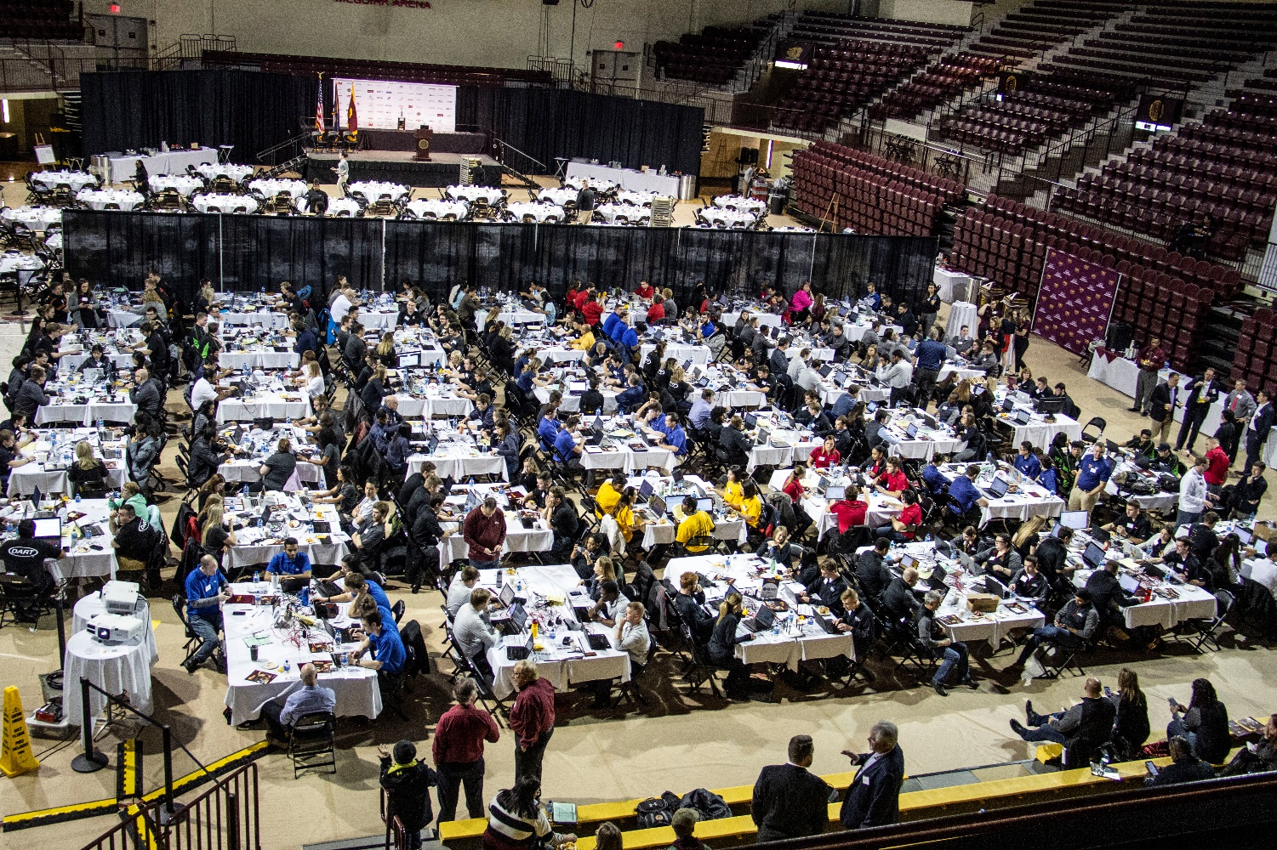


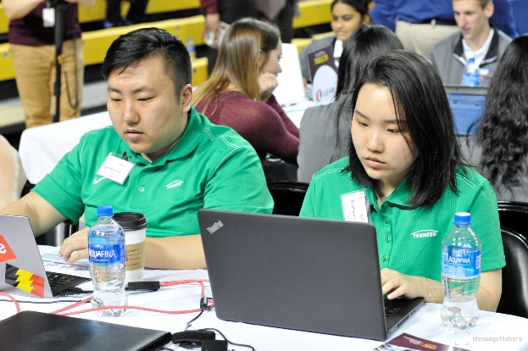
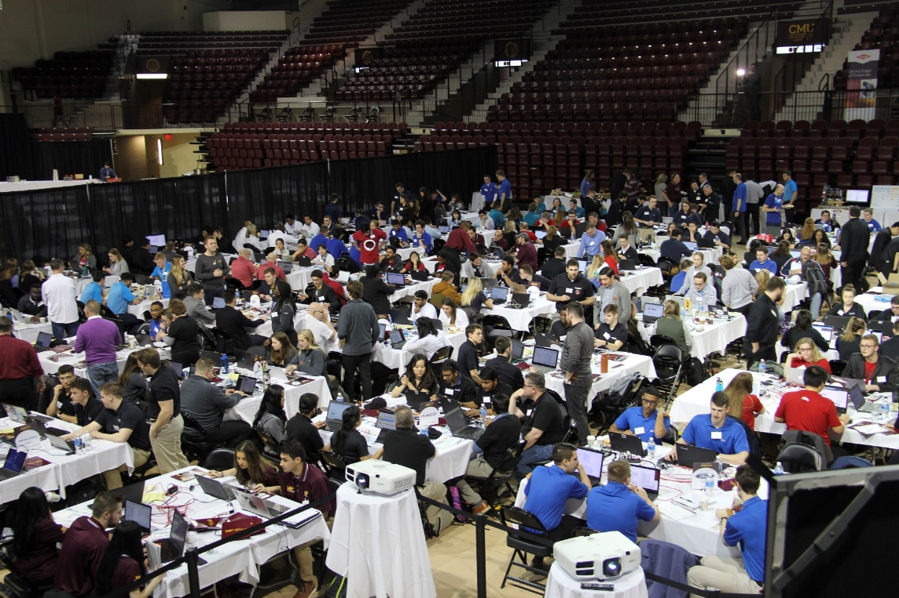
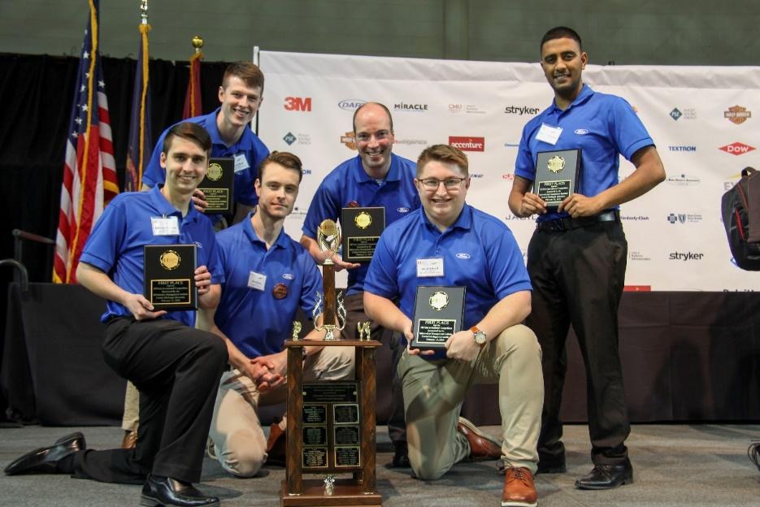
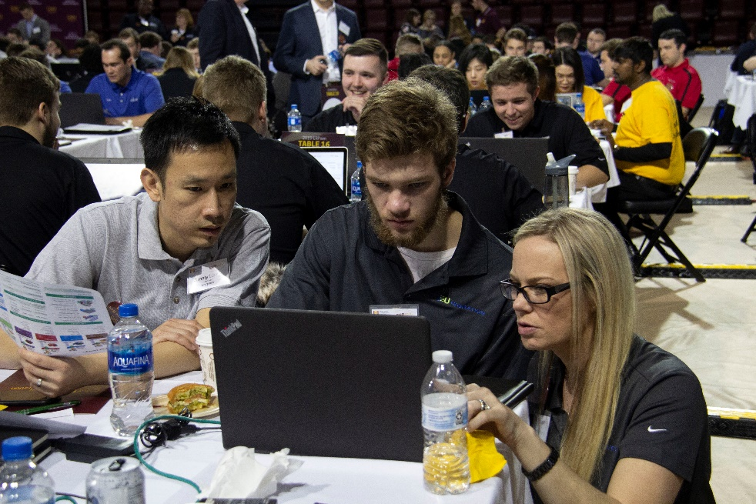
Annual ERPsim Competition

Slide 6
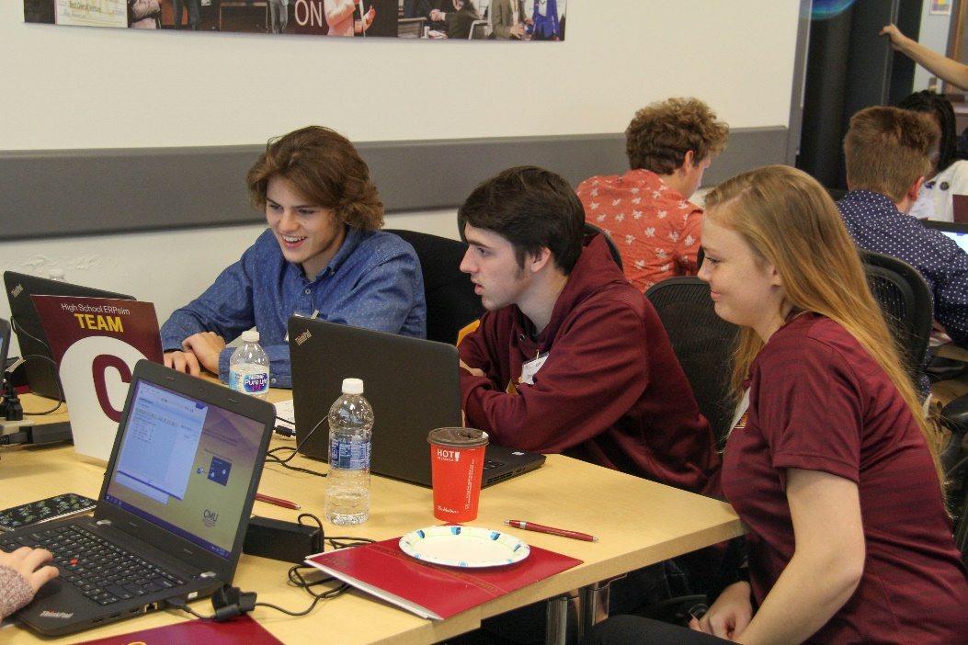
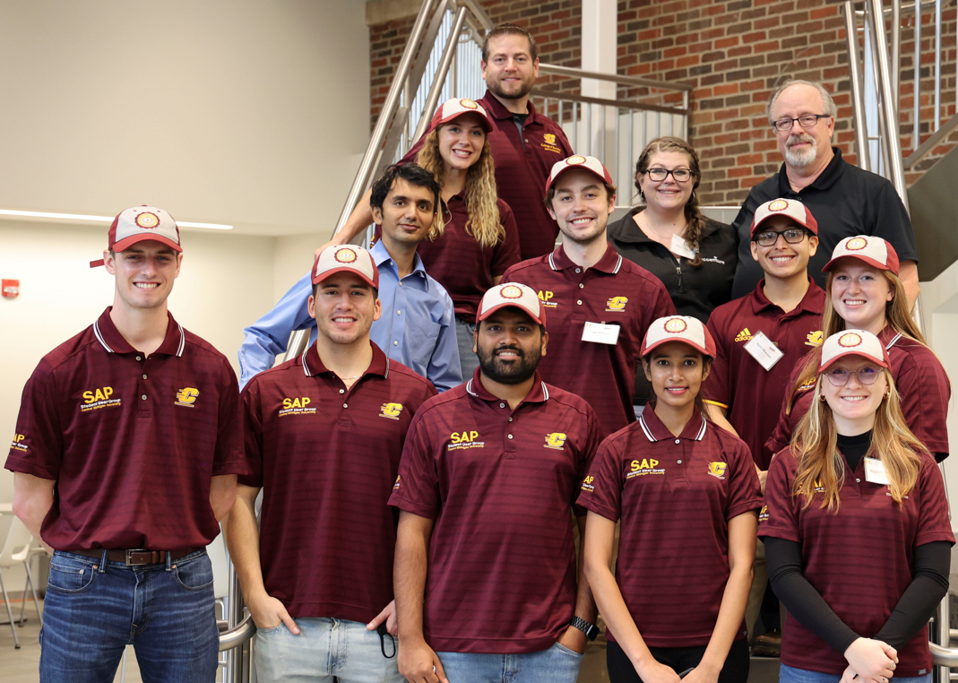
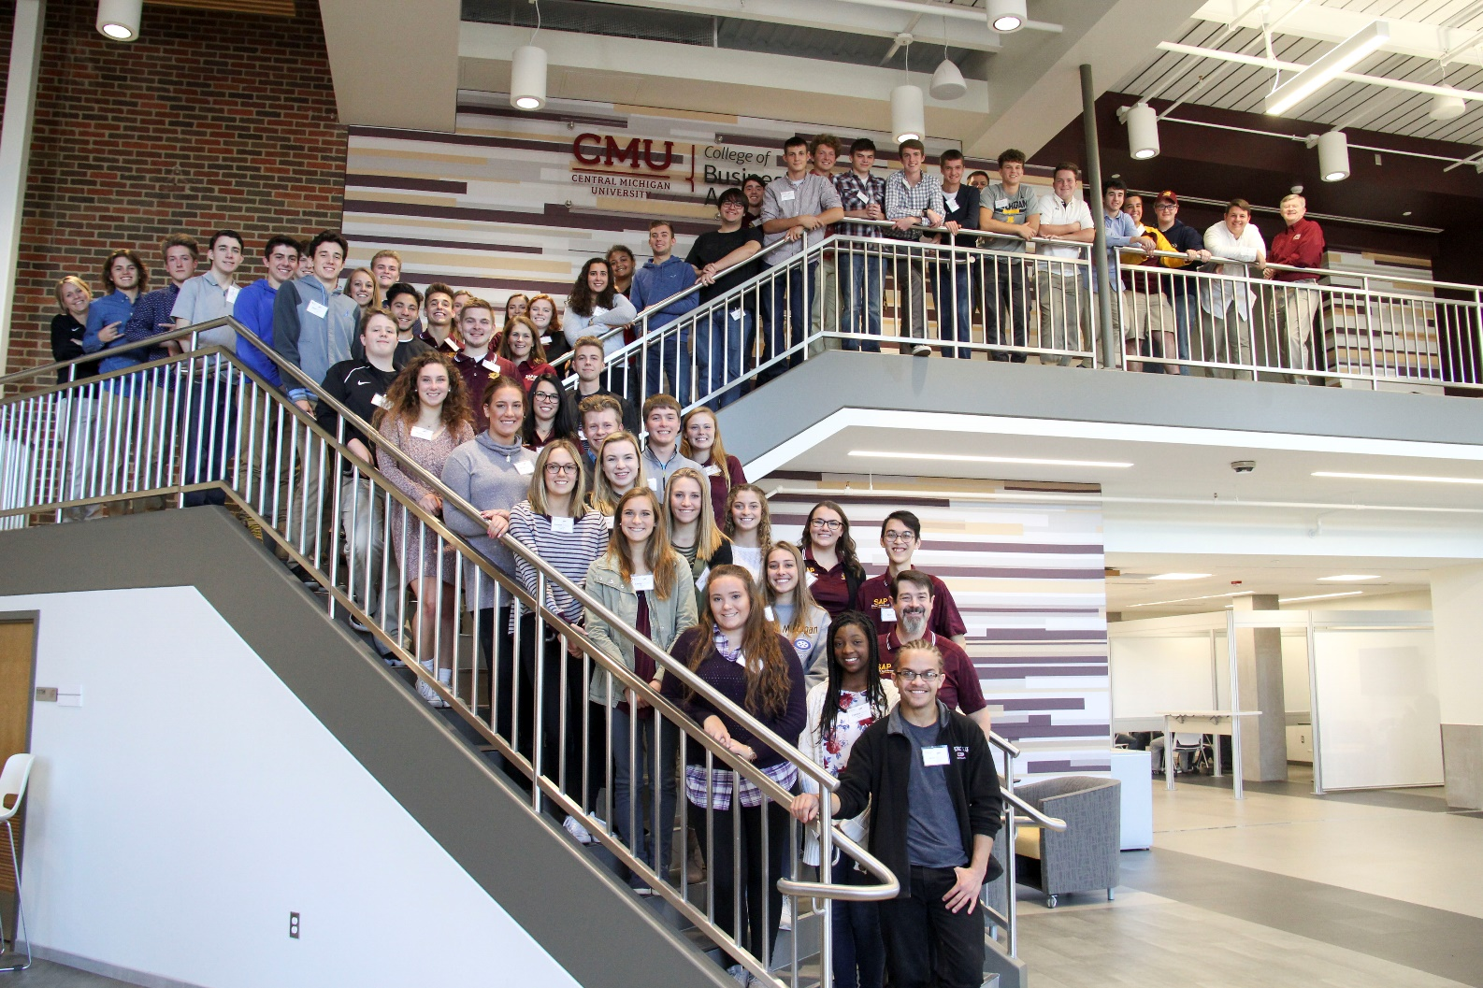
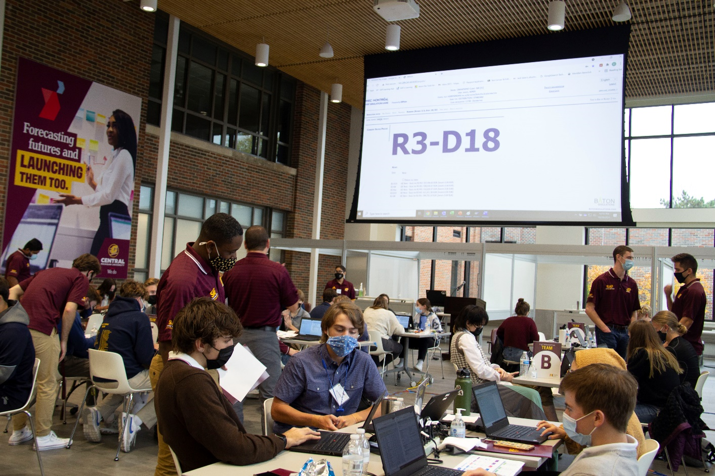
High School ERPsim

Slide 7
“Part” Aspect
This phase allows students to dive deeper in the ERP ecosystem as they tie various functional units in organization together.
Classes ranging from SAP configuration, ABAP, GRC, to special projects.
Students also can avail the opportunity to work with some companies on a project directly. e.g., one of the undergraduate student is doing feasibility study on SAP Green token solution with Dow Chemicals.
Students get rewarded and recognized for their achievements via many awards e.g., Dow Chemical excellent award.
This phase is defined by a relatively lower degree of scaffolding and instructor involvement.
It encourages students to explore topics on their own and ask probing questions to important stakeholders beyond classroom i.e., industry partners. These take form of study abroad and field visits.

Slide 8
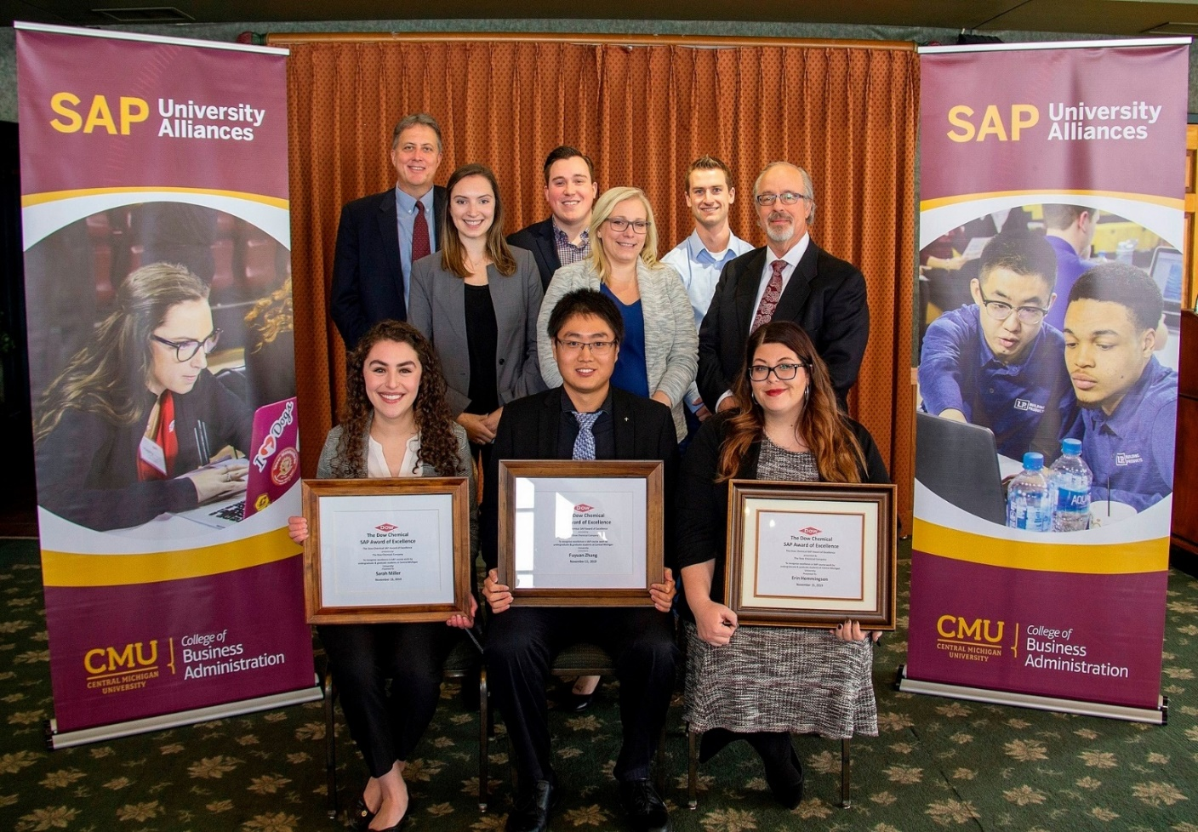
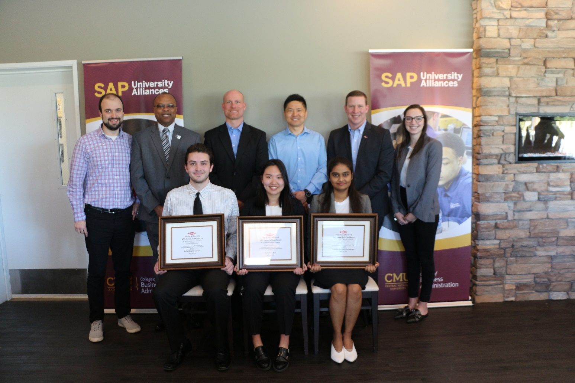
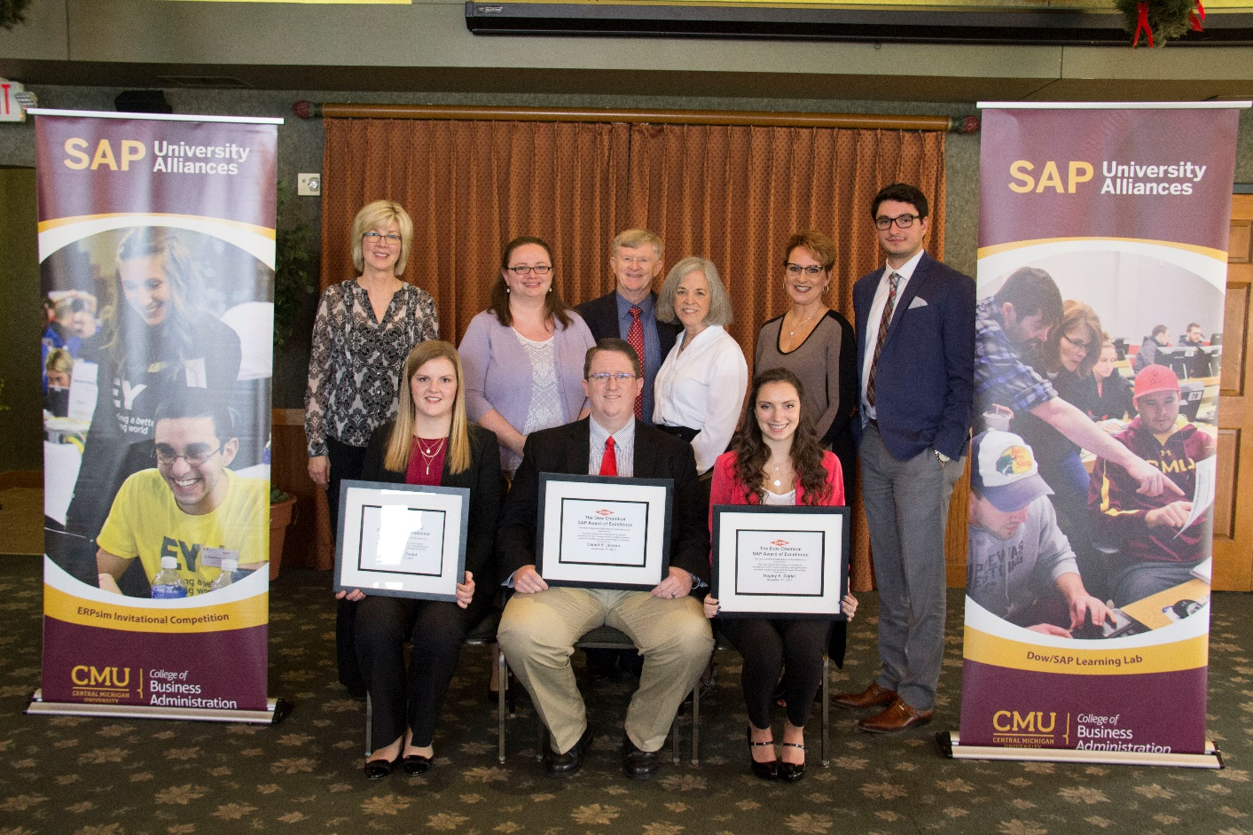
Dow Award of Excellence

Slide 9
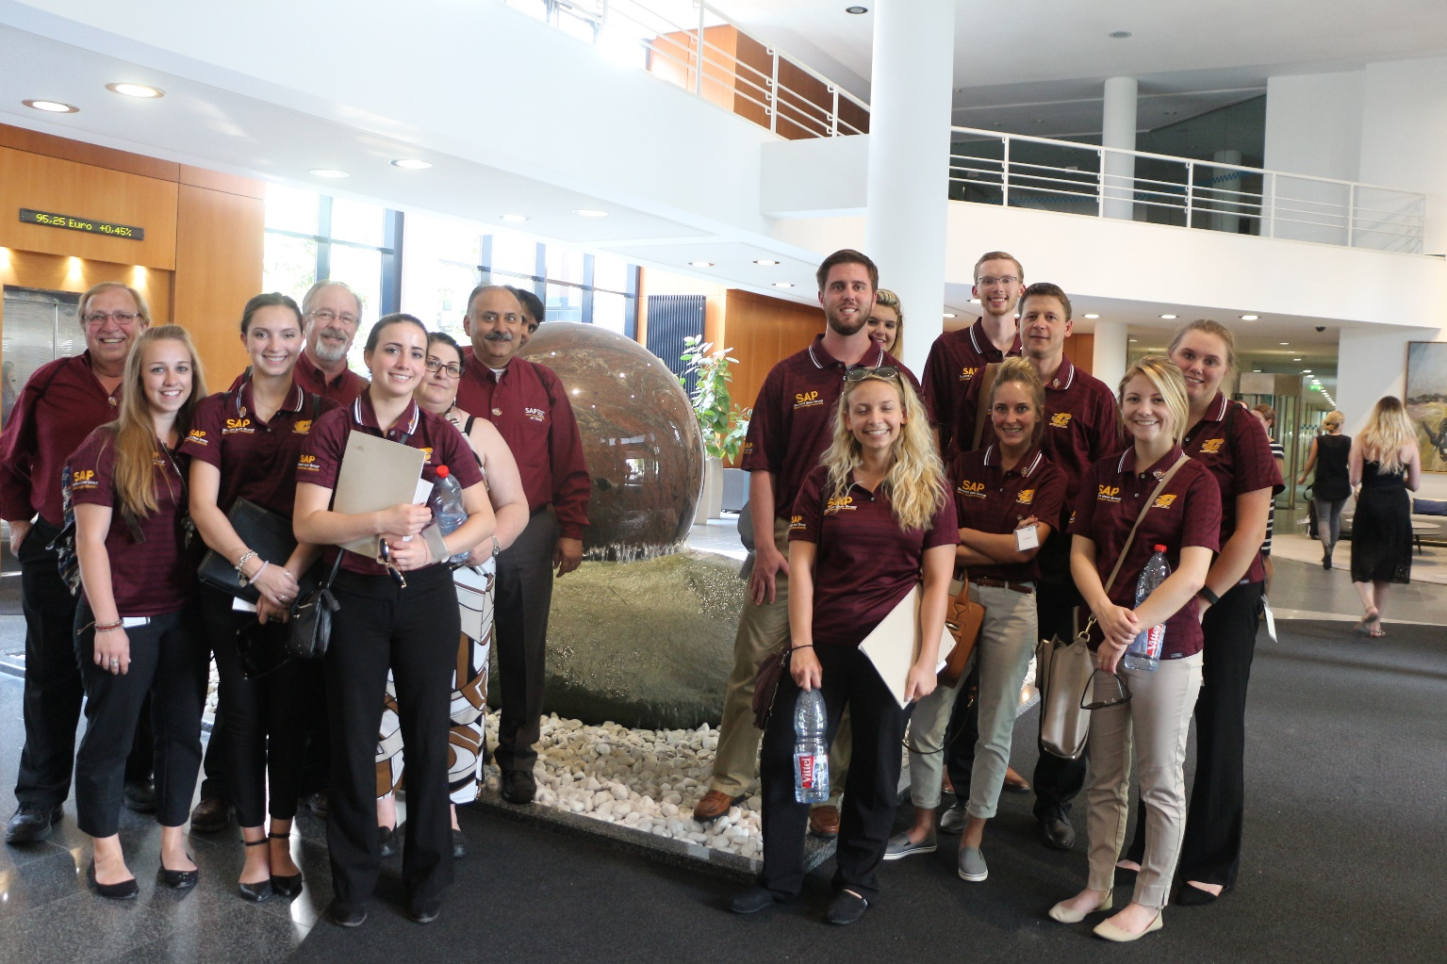
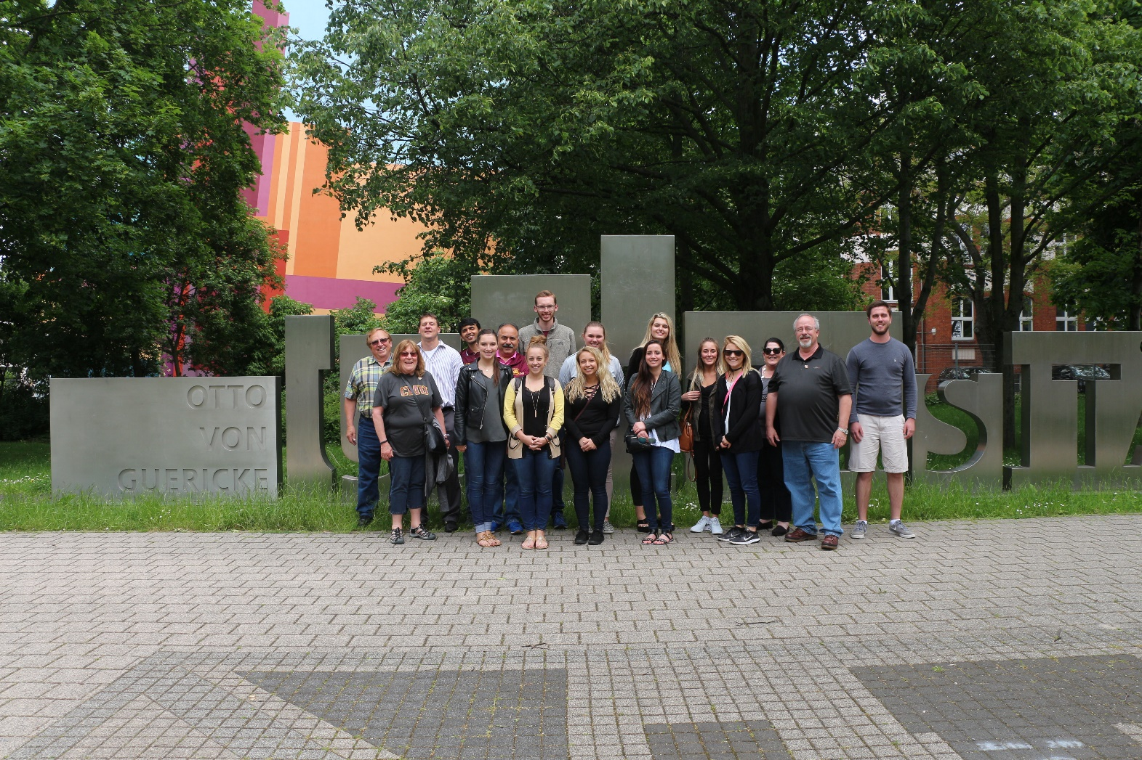
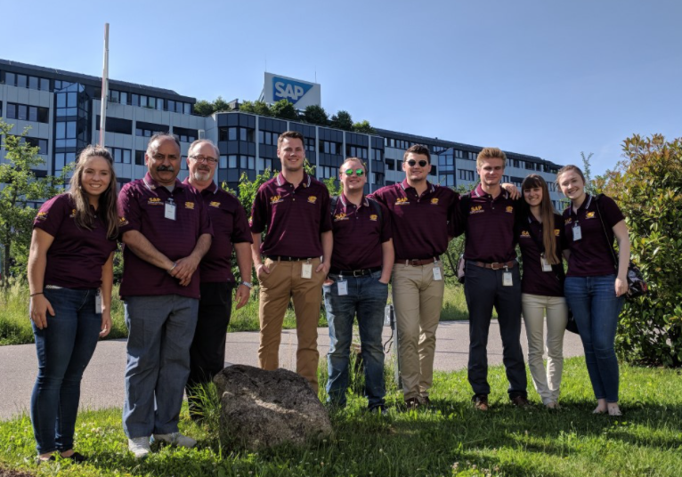
Study Abroad

Slide 10
“Whole” Aspect (again)
This phase is defined by minimal professor/instructor involvement in the learning process and little to no scaffolding.
Working in SAP Next-Gen Lab as assistant on a specific self-guided project or working on SAP sponsored event like Global Datathon.
Select students then gain ability to process and appreciate the whole ERP ecosystem beyond business processes.
Engage in automation using emerging areas like Process Mining. Students create and substantiate their own mental maps beyond traditional business processes.
One must note that these stages are have some overlap and operational similarity and build in each other.

Slide 11
Activities across Whole-part-whole Approach
Coursework
ERPsim Competition (Both High School and University)/SAP University Alliance
Next-Gen Lab
Dow Award of Excellence
ASUG
Process Mining Datathon
Industry projects: Dow, Consumers Energy, Lam Research
Cybersecurity Conference
SAP Student User Group
Field Trips
Study Abroad

Slide 12
Results
Industry-ready students.
Greater degree of applied learning.
Better placements.
Life-long learning opportunities and alumni involvement given the rigor of the program and multiple ways to get involved.
Greater industry involvement.
Our approach to ERP education creates a living and ever-growing learning hub, fostering SAP University Alliance’s vision.

